Slide 1


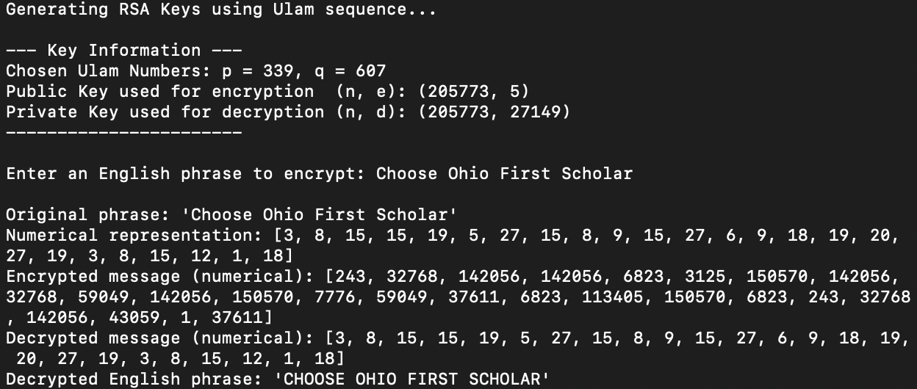
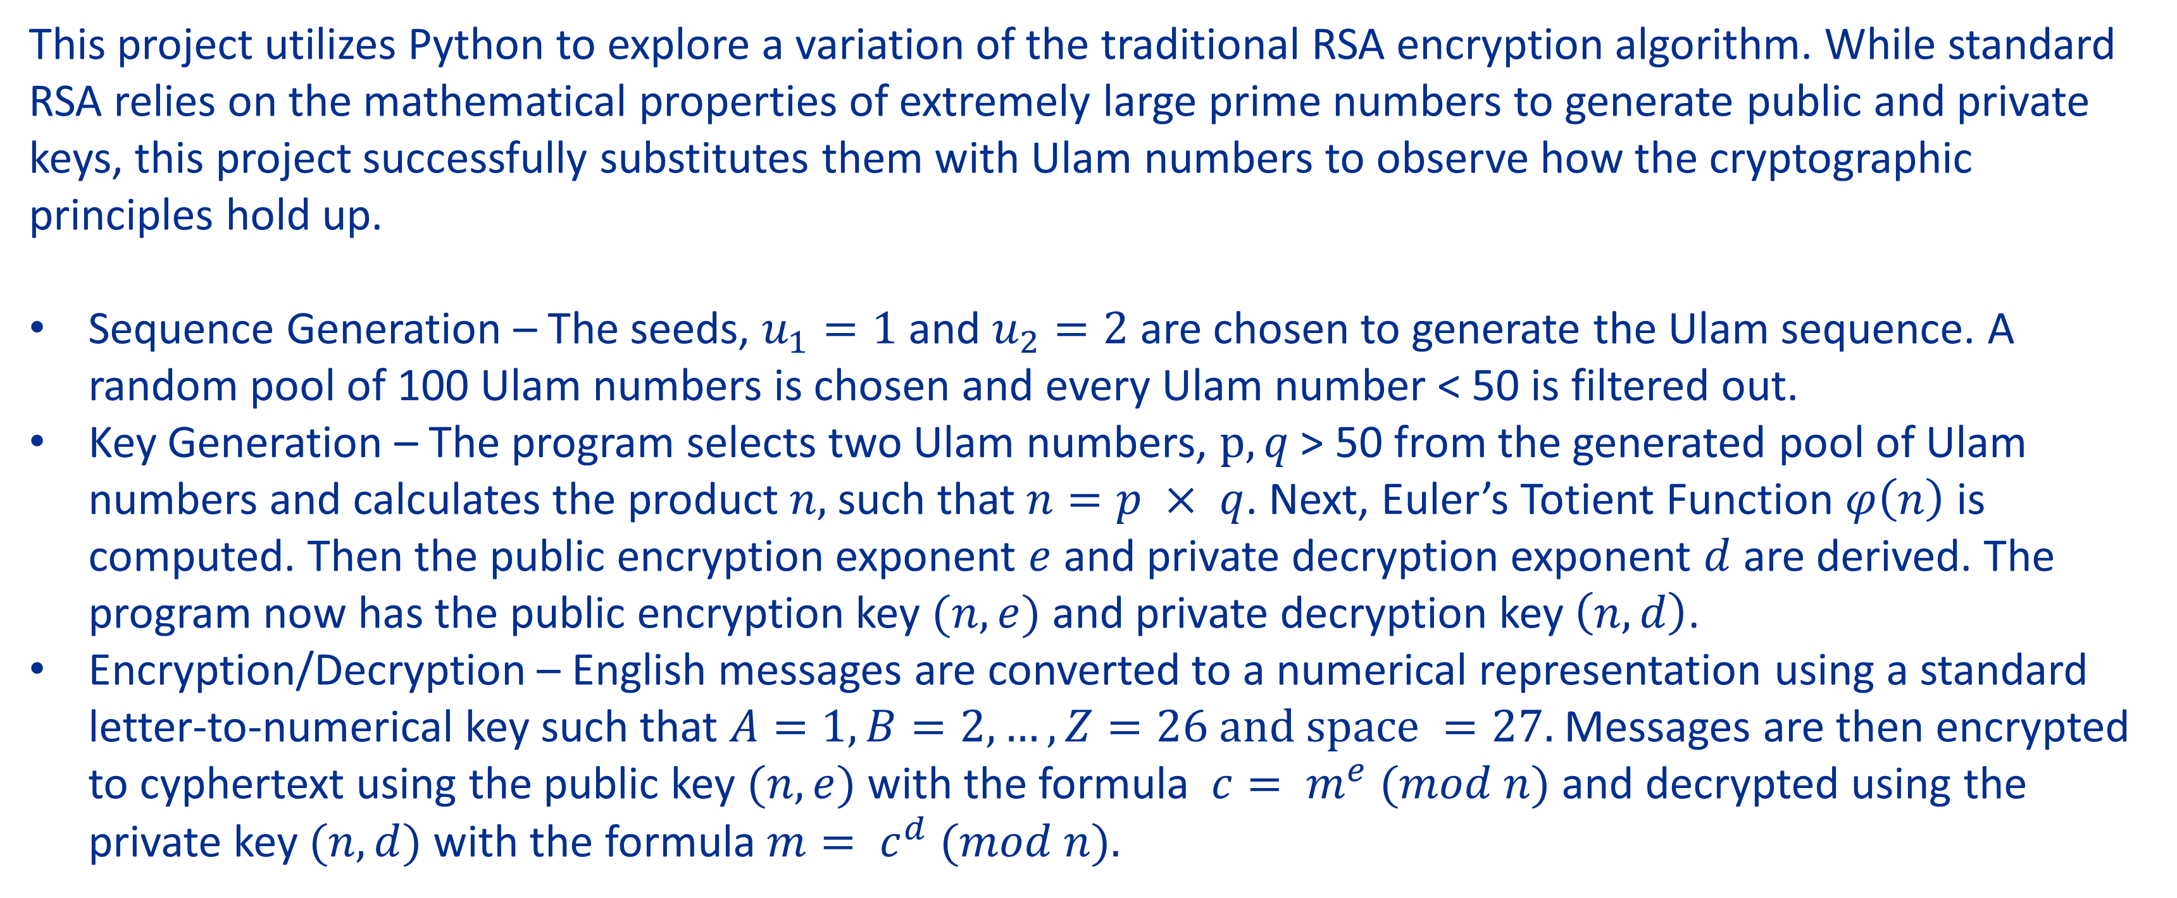
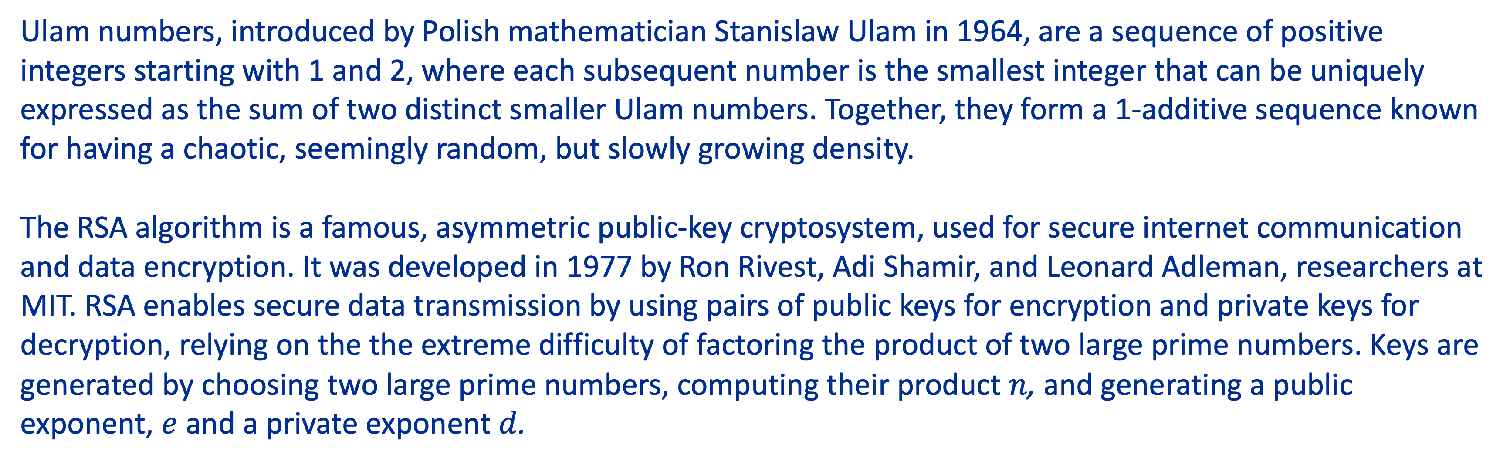
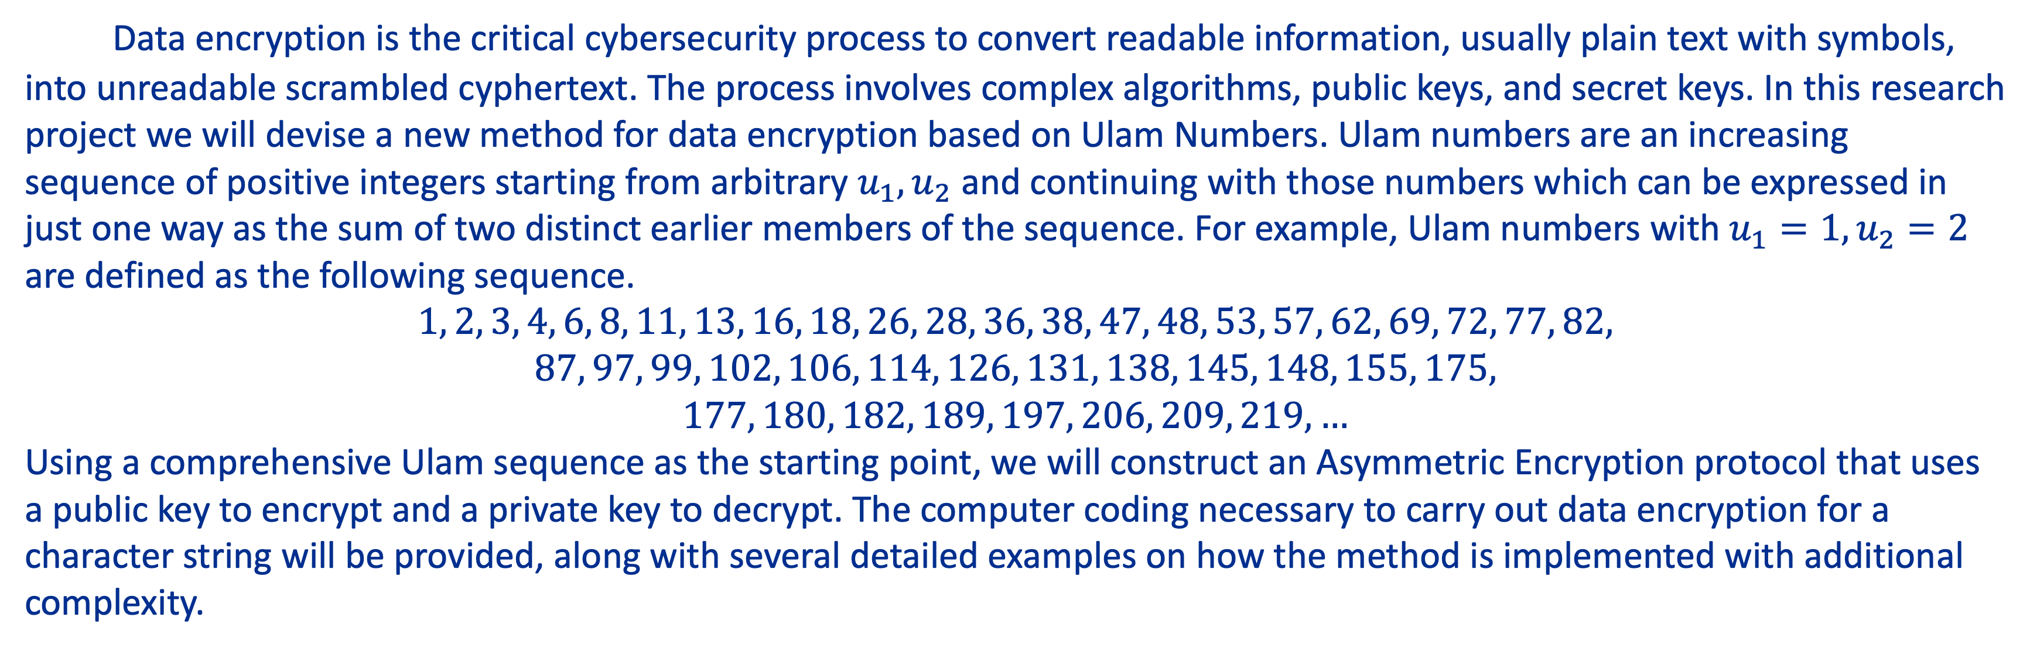
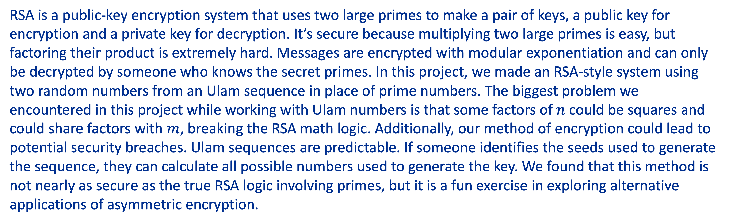
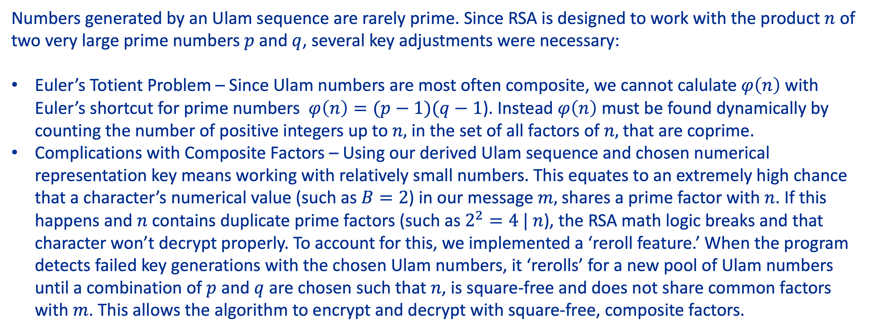
A New Approach to Data Encryption Using Ulam Numbers
Weissman, M. H. (2020). An Illustrated Theory of Numbers. American Mathematical Soc.
Timothy Cherevko, Sydney McGlaughlin
Computer Science, Mathematics
Advisor: Dr. Bathi Kasturiarachi
Kent State University at Stark, North Canton, OH
ABSTRACT
ULAM-RSA: ADAPTATION WITH NON-PRIME NUMBERS
Data encryption is the critical cybersecurity process to convert readable information, usually plain text with symbols, into unreadable scrambled cyphertext. The process involves complex algorithms, public keys, and secret keys. In this research project we will devise a new method for data encryption based on Ulam Numbers. Ulam numbers are an increasing sequence of positive integers starting from arbitrary $u_{1},u_{2}$ and continuing with those numbers which can be expressed in just one way as the sum of two distinct earlier members of the sequence. For example, Ulam numbers with $u_{1}=1,u_{2}=2$ are defined as the following sequence.
$$1, 2, 3, 4, 6, 8, 11, 13, 16, 18, 26, 28, 36, 38, 47, 48, 53, 57, 62, 69, 72, 77, 82,$$
$$87, 97, 99, 102, 106, 114, 126, 131, 138, 145, 148, 155, 175,$$
$$177, 180, 182, 189, 197, 206, 209, 219, …$$
Using a comprehensive Ulam sequence as the starting point, we will construct an Asymmetric Encryption protocol that uses a public key to encrypt and a private key to decrypt. The computer coding necessary to carry out data encryption for a character string will be provided, along with several detailed examples on how the method is implemented with additional complexity.
Numbers generated by an Ulam sequence are rarely prime. Since RSA is designed to work with the product $n$ of two very large prime numbers $p \text{and} q$, several key adjustments were necessary:
Euler’s Totient Problem – Since Ulam numbers are most often composite, we cannot calulate$φ\left(n\right)$ with Euler’s shortcut for prime numbers $φ\left(n\right)=(p−1)(q−1$). Instead $φ\left(n\right)$ must be found dynamically by counting the number of positive integers up to $n,$ in the set of all factors of $n,$ that are coprime.
Complications with Composite Factors – Using our derived Ulam sequence and chosen numerical representation key means working with relatively small numbers. This equates to an extremely high chance that a character’s numerical value (such as $B=2$) in our message $m,$shares a prime factor with $n$. If this happens and $n$ contains duplicate prime factors (such as$2^{2}=4 | n$), the RSA math logic breaks and that character won’t decrypt properly. To account for this, we implemented a ‘reroll feature.’ When the program detects failed key generations with the chosen Ulam numbers, it ‘rerolls’ for a new pool of Ulam numbers until a combination of $p$ and $q$ are chosen such that $n$, is square-free and does not share common factors with $m$. This allows the algorithm to encrypt and decrypt with square-free, composite factors.
BACKGROUND
Ulam numbers, introduced by Polish mathematician Stanislaw Ulam in 1964, are a sequence of positive integers starting with 1 and 2, where each subsequent number is the smallest integer that can be uniquely expressed as the sum of two distinct smaller Ulam numbers. Together, they form a 1-additive sequence known for having a chaotic, seemingly random, but slowly growing density.
The RSA algorithm is a famous, asymmetric public-key cryptosystem, used for secure internet communication and data encryption. It was developed in 1977 by Ron Rivest, Adi Shamir, and Leonard Adleman, researchers at MIT. RSA enables secure data transmission by using pairs of public keys for encryption and private keys for decryption, relying on the the extreme difficulty of factoring the product of two large prime numbers. Keys are generated by choosing two large prime numbers, computing their product $n$, and generating a public exponent, $e$ and a private exponent $d$.
EXAMPLE ENCRYPTION/DECRYPTION
METHODOLOGY
This project utilizes Python to explore a variation of the traditional RSA encryption algorithm. While standard RSA relies on the mathematical properties of extremely large prime numbers to generate public and private keys, this project successfully substitutes them with Ulam numbers to observe how the cryptographic principles hold up.
Sequence Generation – The seeds, $u_{1}=1$ and $u_{2}=2$ are chosen to generate the Ulam sequence. A random pool of 100 Ulam numbers is chosen and every Ulam number < 50 is filtered out.
Key Generation – The program selects two Ulam numbers, $p, q$ > 50 from the generated pool of Ulam numbers and calculates the product $n,$such that $n=p × q$. Next, Euler’s Totient Function $φ\left(n\right)$ is computed. Then the public encryption exponent $e$ and private decryption exponent $d$ are derived. The program now has the public encryption key $(n, e)$ and private decryption key $\left(n, d\right)$.
Encryption/Decryption – English messages are converted to a numerical representation using a standard letter-to-numerical key such that $A=1, B=2, …, Z=26 and space =27.$ Messages are then encrypted to cyphertext using the public key $(n, e)$ with the formula $c= m^{e} (mod n)$ and decrypted using the private key $(n, d)$ with the formula $m= c^{d} (mod n).$
CONCLUSION
RSA is a public-key encryption system that uses two large primes to make a pair of keys, a public key for encryption and a private key for decryption. It’s secure because multiplying two large primes is easy, but factoring their product is extremely hard. Messages are encrypted with modular exponentiation and can only be decrypted by someone who knows the secret primes. In this project, we made an RSA-style system using two random numbers from an Ulam sequence in place of prime numbers. The biggest problem we encountered in this project while working with Ulam numbers is that some factors of $n$could be squares and could share factors with $m$, breaking the RSA math logic. Additionally, our method of encryption could lead to potential security breaches. Ulam sequences are predictable. If someone identifies the seeds used to generate the sequence, they can calculate all possible numbers used to generate the key. We found that this method is not nearly as secure as the true RSA logic involving primes, but it is a fun exercise in exploring alternative applications of asymmetric encryption.
REFERENCES
GeeksforGeeks. (2025, July 23). RSA Algorithm in Cryptography. GeeksforGeeks. https://www.geeksforgeeks.org/computer-networks/rsa-algorithm-cryptography/
Sloane, N. J. A., & McCraine, J. (2026, April 12). A002858. The Online Encyclopedia of Integer Sequences. https://oeis.org/A002858
Weissman, M. H. (2020). An Illustrated Theory of Numbers. American Mathematical Soc.
Weisstein, Eric W. “Ulam Sequence.” From MathWorld—A Wolfram Resource. https://mathworld.wolfram.com/UlamSequence.html

